Slide 1




Slide 2
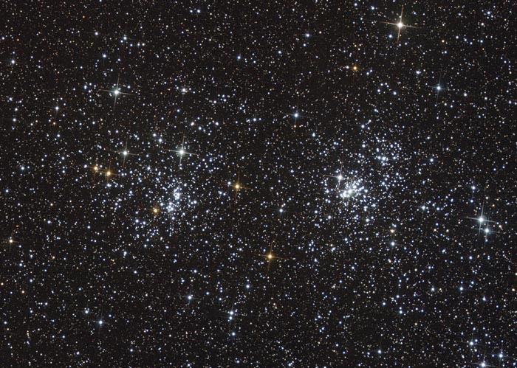
h & χ Persei Through the Telescope

Slide 3
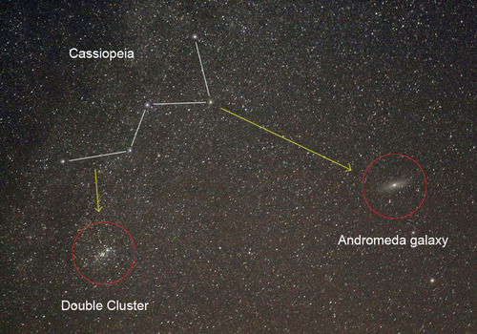
h & χ Persei In the Night Sky
h and chi (χ) Persei can be found near the “W” of Cassiopeia.

Slide 4
What are h & χ Persei?
h and chi (χ) Persei are a pair of open star clusters. They are several hundred light years apart but they look close together because they are in the same direction when seen from Earth.

Slide 5
What is an Open Cluster?
An open cluster is a group of young stars, that have all “recently” formed from a large cloud of interstellar gas called a nebula.
Open clusters typically contain a few hundred to a few thousand stars.

Slide 6
How far away are h & χ Persei?
It takes over 7,000 years for light to travel from the double cluster to Earth.

Slide 7
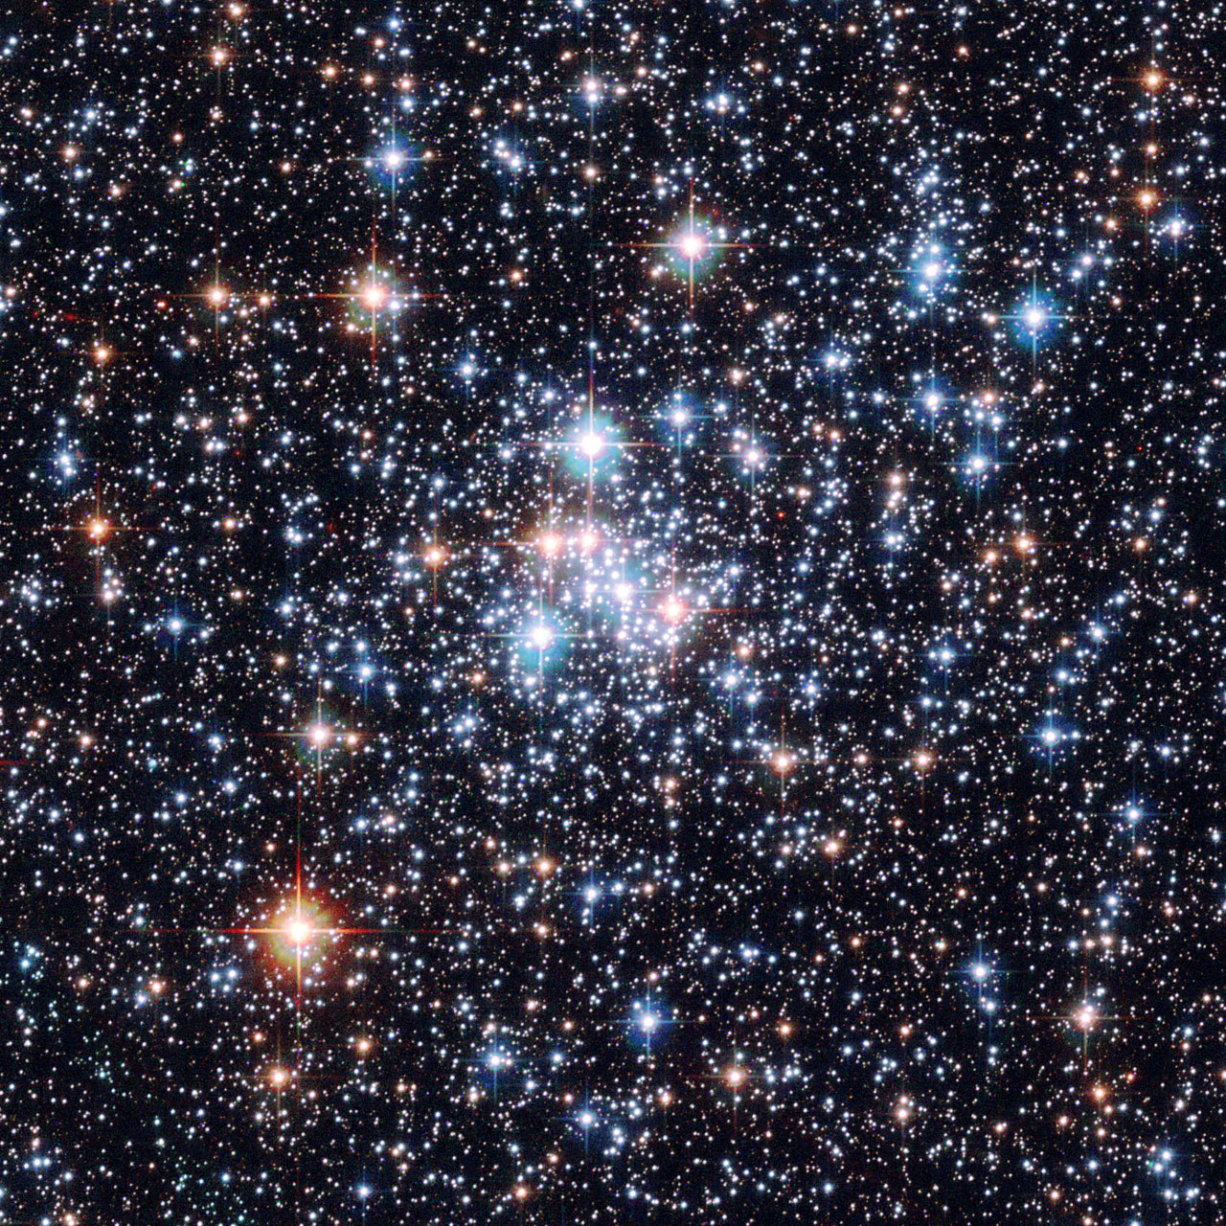
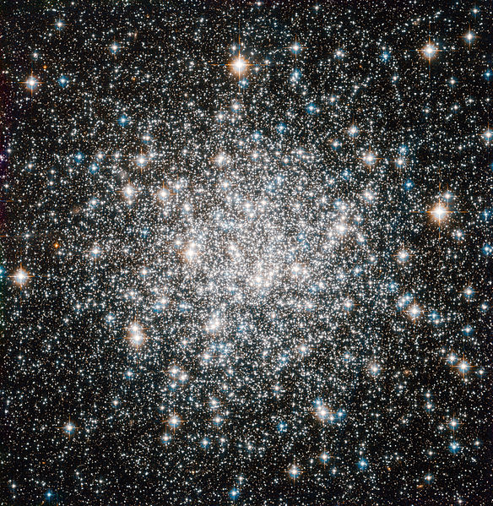
Star Clusters - 1920s
In the 1920’s, astronomers recognized the fact that there were star clusters but at that time they did not understand their significance.

Slide 8
Star Clusters - 1920s
In the 1920’s astronomers also knew that there were two types of star clusters but, did not understand their differences.

Slide 9
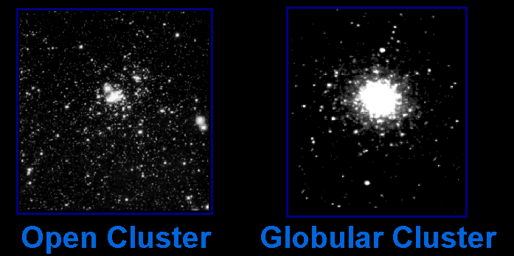
Star Clusters - Now
Today astronomers know that there are two main types of star clusters in our galaxy …

Slide 10
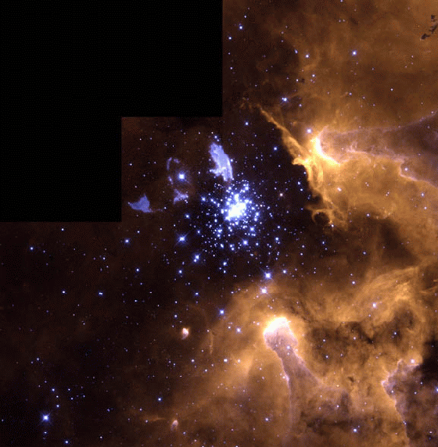
Star Clusters - Now
Open clusters are made of young stars recently formed from vast clouds of interstellar gas and dust.

Slide 11
Star Clusters - Now
Globular clusters, on the other hand, are made of stars as old as the galaxy itself.

Slide 12
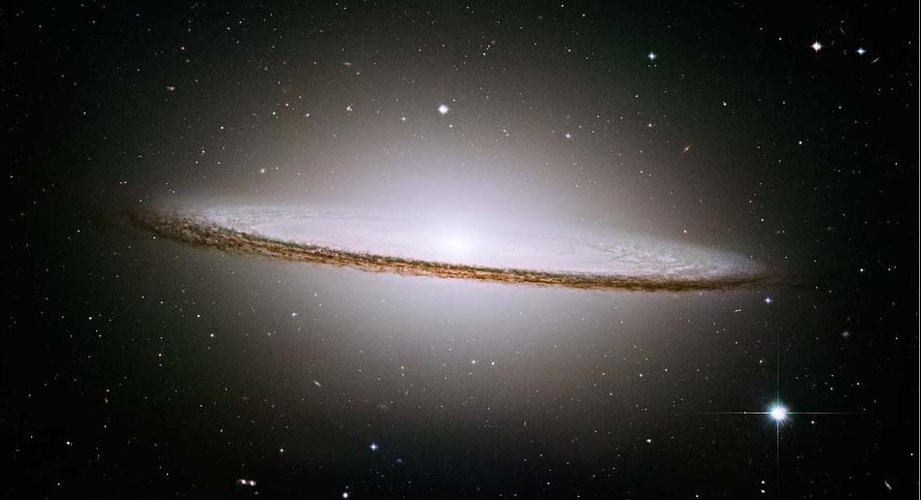
Star Clusters 101
Star Clusters - Now
Open clusters exist within the disc of the galaxy. Globular clusters exist above and below the plane of the galaxy.
globular clusters
open clusters
halo
Central bulge
disk
disk

Slide 13
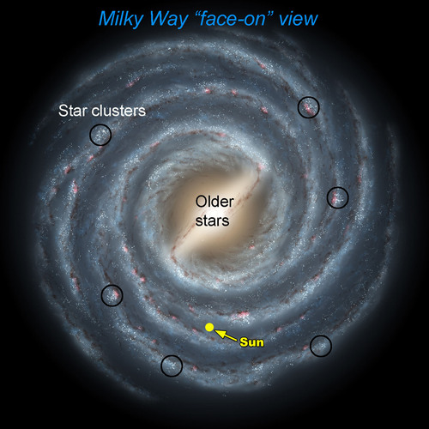
Star Clusters - Now
Open clusters are found in the spiral arms in the disk of spiral galaxies like ours.

Slide 14
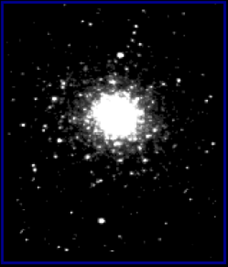

Open and Globular Star Clusters Are Different Sizes
Open Cluster
Globular Cluster
are about 30 light years across.
are about 150 light years across.
Open clusters are 5 times smaller than globular clusters. They only look the same size because they are closer.

Slide 15
Open and Globular Star Clusters Are Different Sizes
Open Cluster
Globular Cluster
have hundreds to thousands of stars.
have thousands to nearly a million stars.

Slide 16
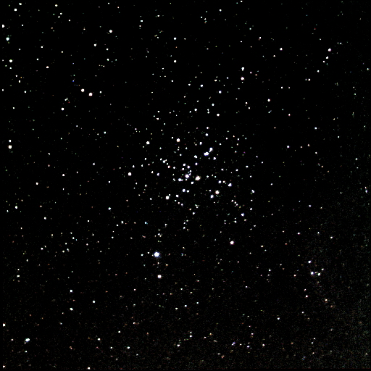
Open Clusters
of the Milky Way
“Mature” open star clusters have used up all of their gas forming new stars. For a few million years these stars will lie together in space.

Slide 17
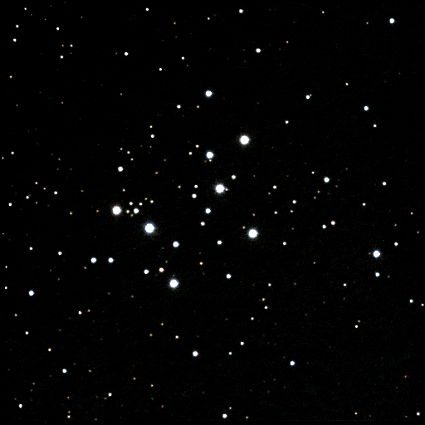
Open Clusters of the Milky Way
Because the stars are only weakly held together by their mutual gravity, they eventually begin to drift apart.
This is a smattering of stars that once was an open cluster.

Slide 18
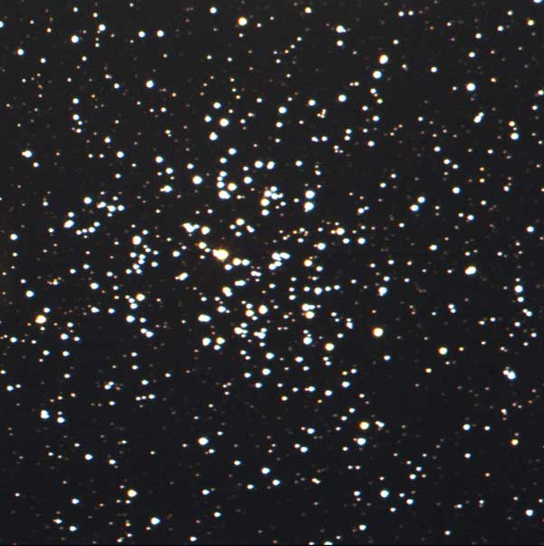
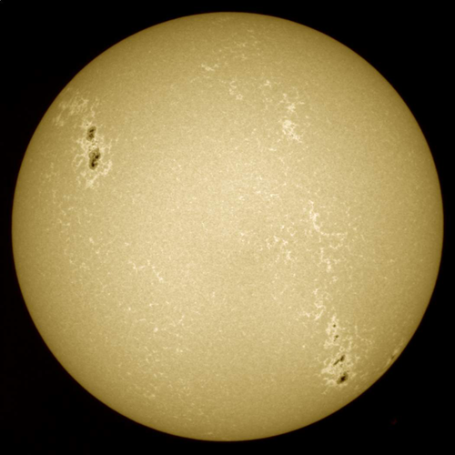
Open Clusters Destiny
Our Sun originated in an open cluster similar to this one about 5 billion years ago.

